Slide 1
HW4
Xinying Wu
15620161152288

Slide 2
#install.packages("rjson", repos="http://cran.us.r-project.org") library("rjson") json_file = "http://crix.hu-berlin.de/data/crix.json" json_data = fromJSON(file=json_file) crix_data_frame = as.data.frame(json_data) n=dim(crix_data_frame) a=seq(1,n[2],2) b=seq(2,n[2],2) date=t(crix_data_frame[1,a]) price=t(crix_data_frame[1,b]) ts.plot(price)

Slide 3
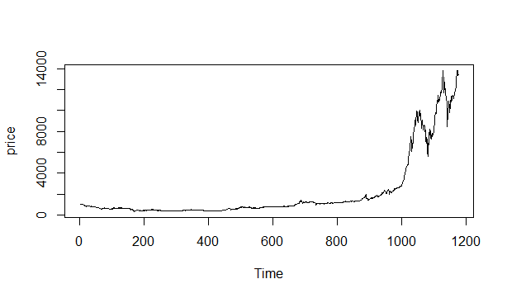

Slide 4
#install.packages("rjson", repos="http://cran.us.r-project.org")
library("rjson")
json_file = "http://crix.hu-berlin.de/data/crix.json"
json_data = fromJSON(file=json_file)
crix_data_frame = as.data.frame(json_data)
n=dim(crix_data_frame)
a=seq(1,n[2],2)
b=seq(2,n[2],2)
date=t(crix_data_frame[1,a])
price=t(crix_data_frame[1,b])
ts.plot(price)
ret=diff(log(price))
ts.plot(ret)
> pdf(file="myplot.pdf")
> dev.off()

Slide 5
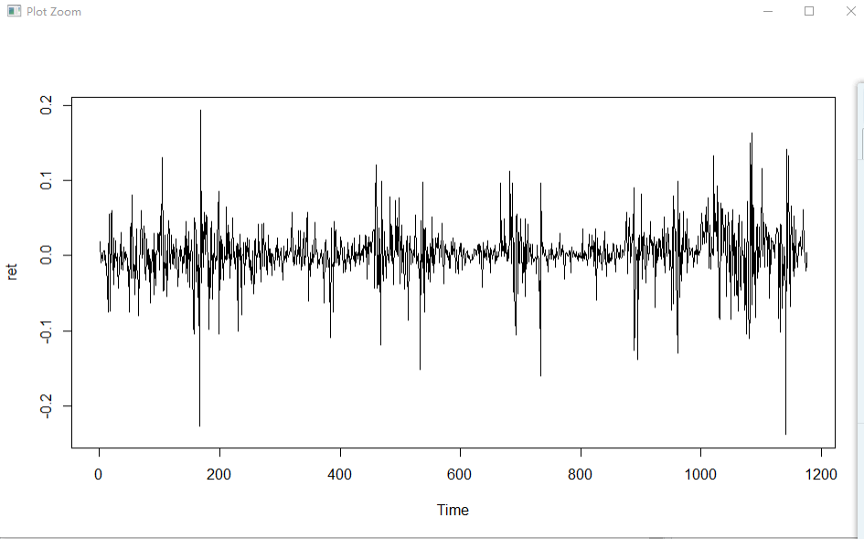

Slide 6
# histogram of returns
hist(ret, col = "cyan", breaks = 20, freq = FALSE, ylim = c(0, 25), xlab = NA)
lines(density(ret), lwd = 1)
mu = mean(ret)
sigma = sd(ret)
x = seq(-4, 4, length = 100)
curve(dnorm(x, mean = mean(ret), sd = sd(ret)), add = TRUE, col = "darkblue", lwd = 1)

Slide 7
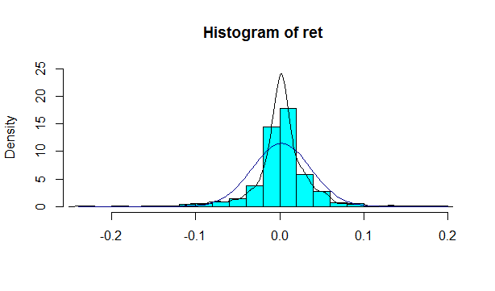
figure5

Slide 8
# let's check it by qq-plot
qqnorm(ret,ylim = c(-6, 6))
qqline(ret, col = "darkblue", lwd = 2)

Slide 9
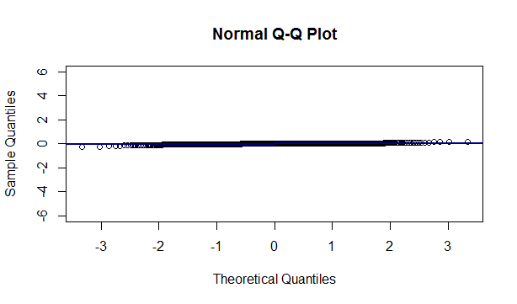

Slide 10
# plot acf autocorr = acf(ret, lag.max = 20, ylab = "Sample Autocorrelation", main = NA,lwd = 1, ylim = c(-0.2, 1))

Slide 11
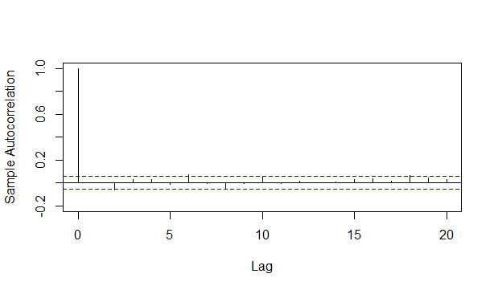
figure6.1

Slide 12
# plot of pacf autopcorr = pacf(ret, lag.max = 20, ylab = "Sample Partial Autocorrelation", main = NA, ylim = c(-0.3, 0.3), lwd = 2)

Slide 13
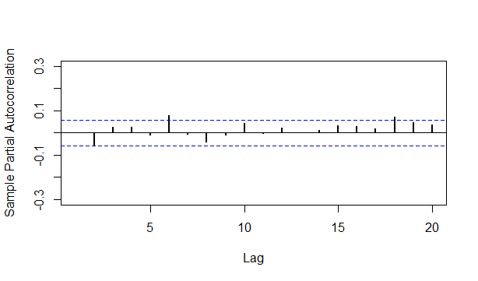
figure6.2

Slide 14
# select p and q order of ARIMA model fit4 = arima(ret, order = c(2, 0, 3)) tsdiag(fit4) Box.test(fit4$residuals, lag = 1)

Slide 15
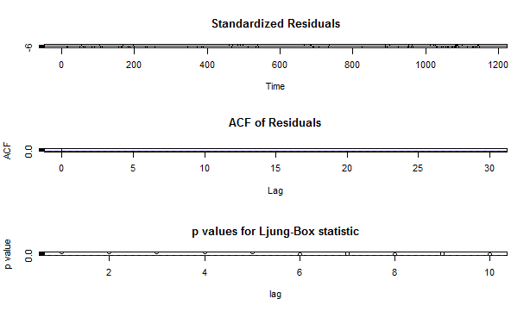

Slide 16
fitr4 = arima(ret, order = c(2, 1, 3)) tsdiag(fitr4) Box.test(fitr4$residuals, lag = 1) > # to conclude, 202 is better than 213 > fit202 = arima(ret, order = c(2, 0, 2)) > tsdiag(fit202) > tsdiag(fit4) > tsdiag(fitr4)

Slide 17
> # arima202 predict > fit202 = arima(ret, order = c(2, 0, 2)) > crpre = predict(fit202, n.ahead = 30) > dates = seq(as.Date("02/08/2014", format = "%d/%m/%Y"), by = "days", length = length(ret)) > plot(ret, type = "l", xlim = c(0, 644), ylab = "log return", xlab = "days",lwd = 1.5) > lines(crpre$pred, col = "red", lwd = 3) > lines(crpre$pred + 2 * crpre$se, col = "red", lty = 3, lwd = 3) > lines(crpre$pred - 2 * crpre$se, col = "red", lty = 3, lwd = 3)

Slide 18
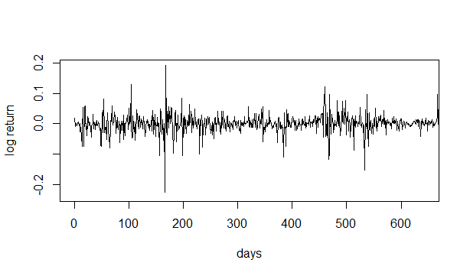
figure7

